Slide 1
Category review: Chips
June 2020
Retail Analytics

Slide 2
Notes:
To view Privacy video explaining how important data privacy is to Quantium, please click here: https://www.youtube.com/watch?v=Zq1QDAkoRzU
or here Q:\Company Reference\Brand & Design\Brand videos\Q Privacy.mp4
At Quantium, we believe that data is the behavioural footprint of humanity and that it has to be treated with the utmost care and responsibility.
Histories, attitudes, indeed lives are stored within it in ways that aren’t always apparent – and that’s what makes its potential so powerful.
To work with it responsibly, sensitively, we set ourselves the highest data privacy protection and governance standards.
We have spent 17 years perfecting privacy-by-design and secure-by-design principles. Central to this is not holding any personally identifiable information about people –
we neither receive it, and put the necessary protections in place to be unable to decipher it.
Every aspect of handling data is safeguarded: from its de-identification, to its encryption – data security is paramount and of the highest grade.
We pride ourselves on gaining the trust of iconic organisations around the world through years of securely working with their data,
and in turn the trust that builds with their stakeholders.

Slide 3
Executive summary
Data preparation and customer analytics
The task was to present a strategic recommendation to the client that is supported by data which can be further used for the upcoming category review. The insights from this analysis will feed into the supermarket’s strategic plan for the chip category in the next half year. Some of the main tasks are as follows -:
Examine transaction data and customer data.
Data analysis and customer segments.
Deep dive into customer segments.
Visualization of data.
01
Task 1
02
Task 2
Experimentation and uplift testing
The task was to test the impact of the new trial layouts with a data driven recommendation to whether or not the trial layout should be rolled out to all their stores. Some of the main tasks are as follows -:
Select control store
Assessment of the trail
Collate findings

Slide 4
Task 1- Data preparation and customer analytics
Categories
Customers – Divided on the basis of
LIFESTAGE – MIDAGE SINGLE/COUPLES, NEW FAMILIES, OLDER FAMILES, OLDER SINGLES/COUPLES, RETIREES , YOUNG FAMILIES AND YOUNG SINGLES/COUPLES
PREMIUM CUSTOMERS – BUDGET, MAINSTREAM AND PREMIUM
Chips – Divided on the basis of
BRANDS – Chips were categorized on the basis of brands such as Doritos, Pringles, Kettles etc
PACK SIZE – Chips were categorized under different pack size such as 170g, 380g, 175g etc

Slide 5
Overview:
Sales have mainly been due to Budget - older families, Mainstream - young singles/couples, and Mainstream retirees shoppers. We found that the high spend in chips for mainstream young singles/couples and retirees is due to there being more of them than other buyers. Mainstream, midage and young singles and couples are also more likely to pay more per packet of chips. This is indicative of impulse buying behavior.
We’ve also found that Mainstream young singles and couples are 23% more likely to purchase Tyrrells chips compared to the rest of the population
Also the pack size of 170g , 175g and 380 are the most preferred ones

Slide 6
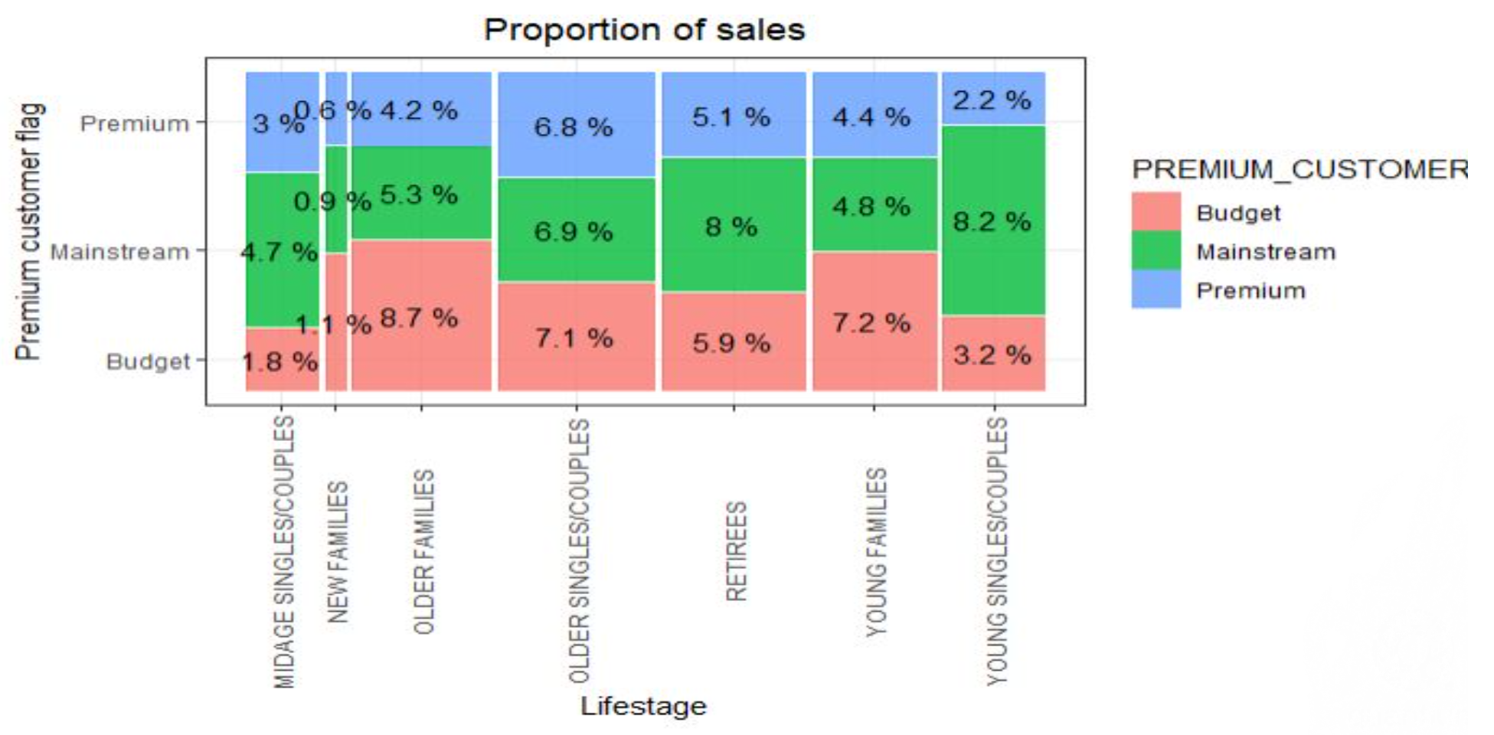
Total no of sales according to the LIFESTAGE and PREMIUM CUSTOMERS

Slide 7
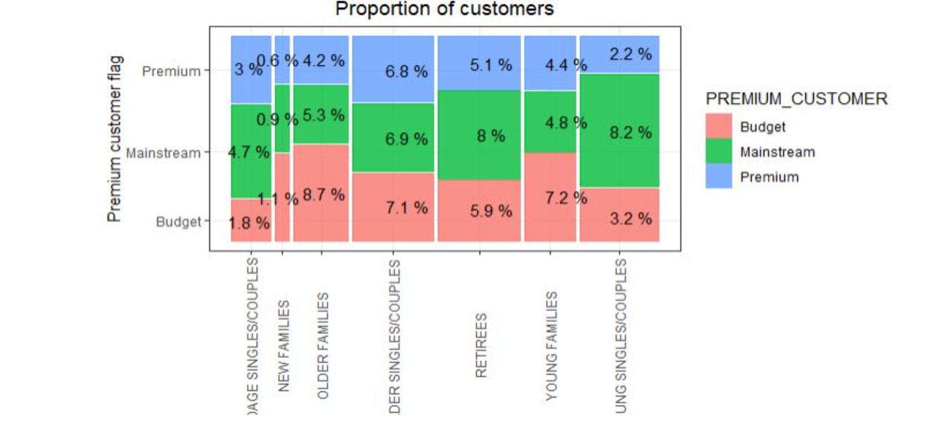
Editable (delete this)
Proportion of customers by Affluence and LIFESTAGE

Slide 8
Task -2
Trial store performance
We’ve found control stores 233, 155, 237 for trial stores 77, 86 and 88 respectively.
The results for trial stores 77, 86 and 88 during the trial period show a significant difference in at least two of the three trial months.

Slide 9
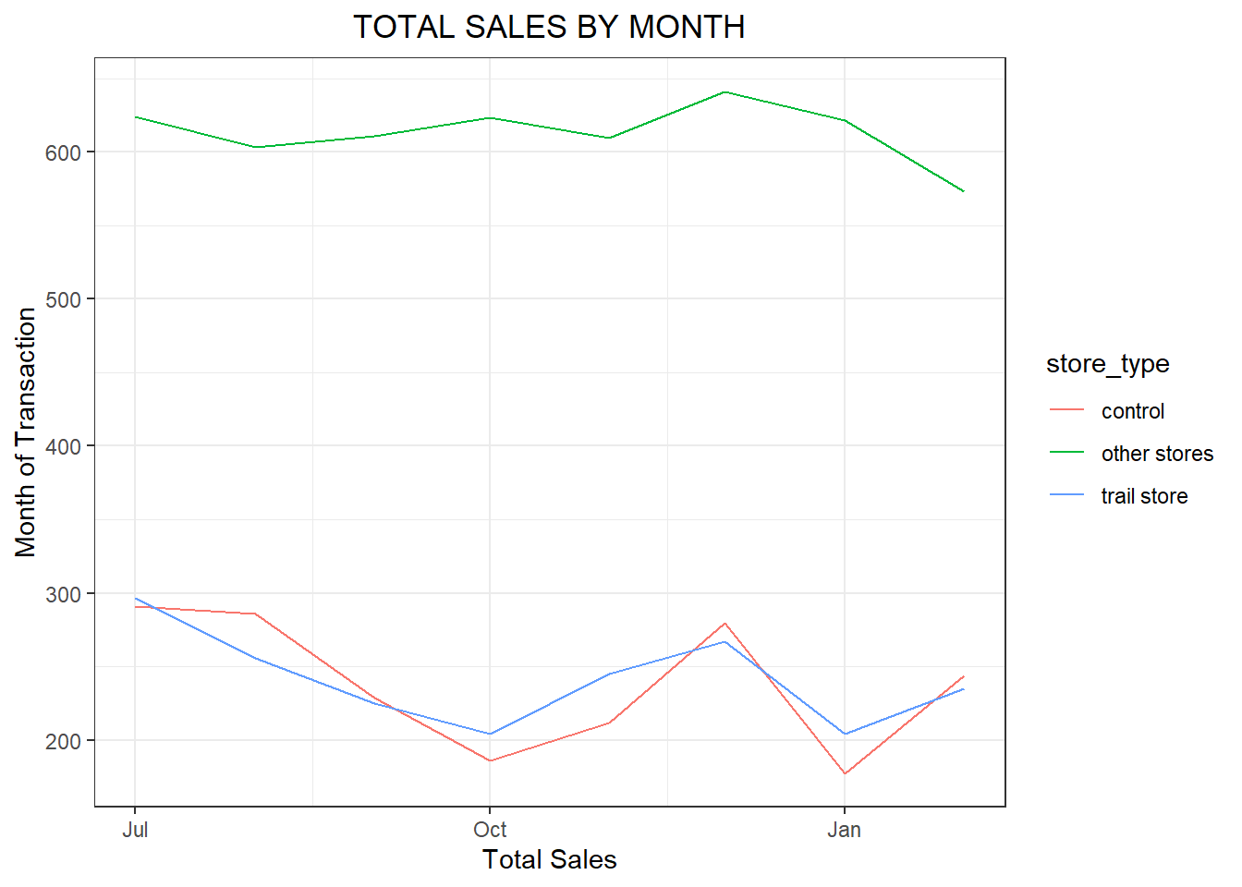
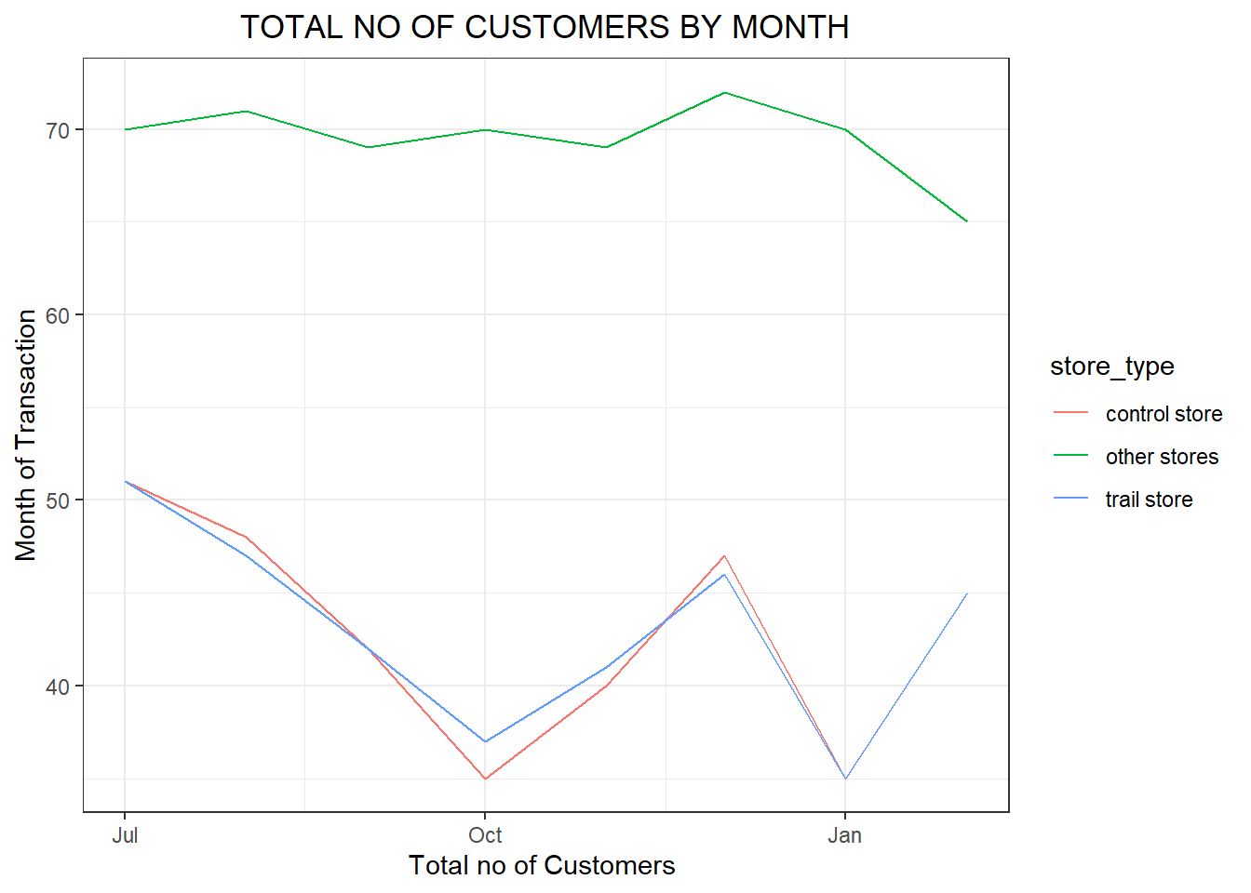
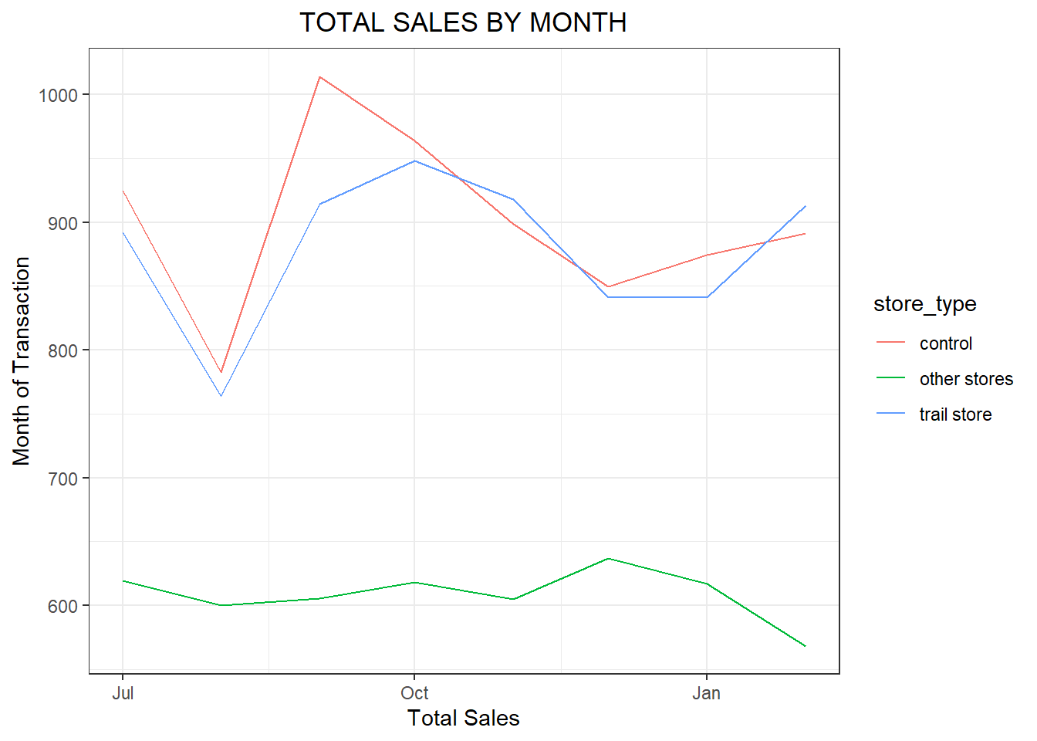
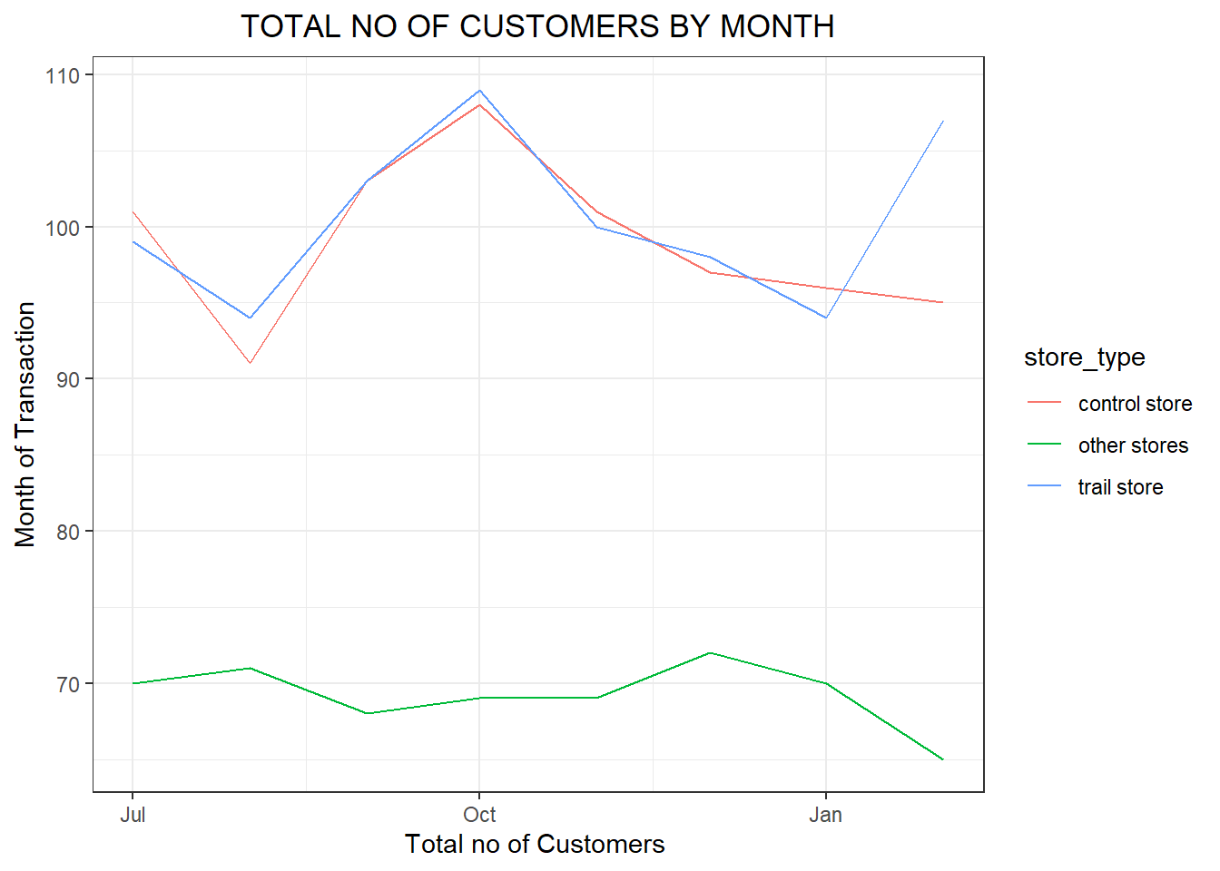
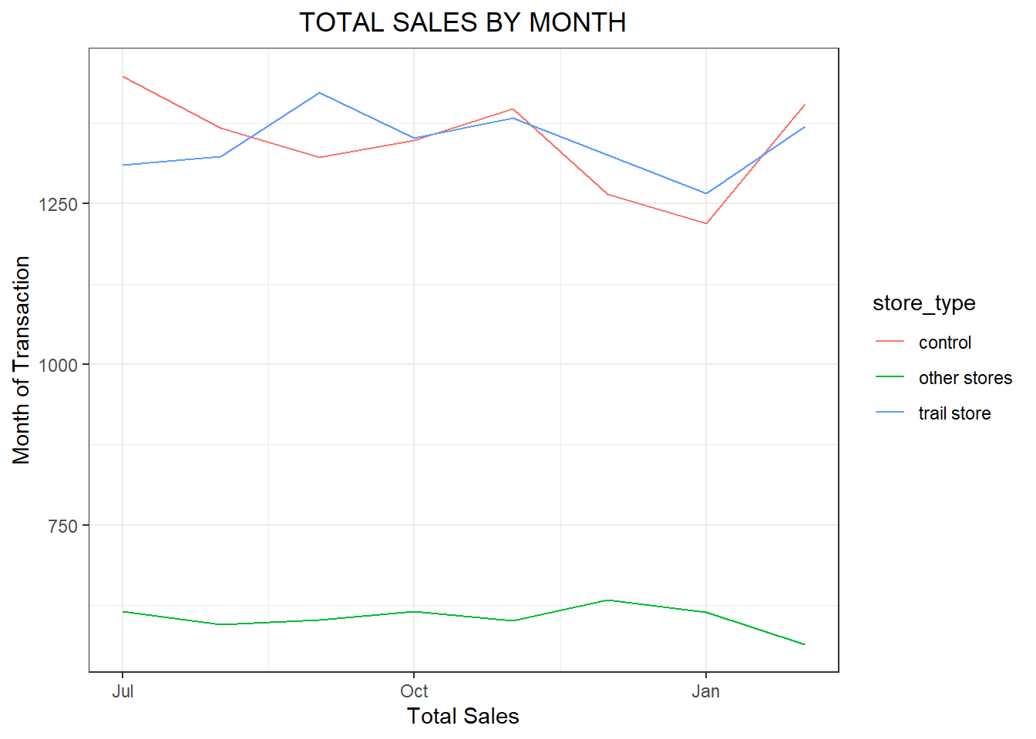
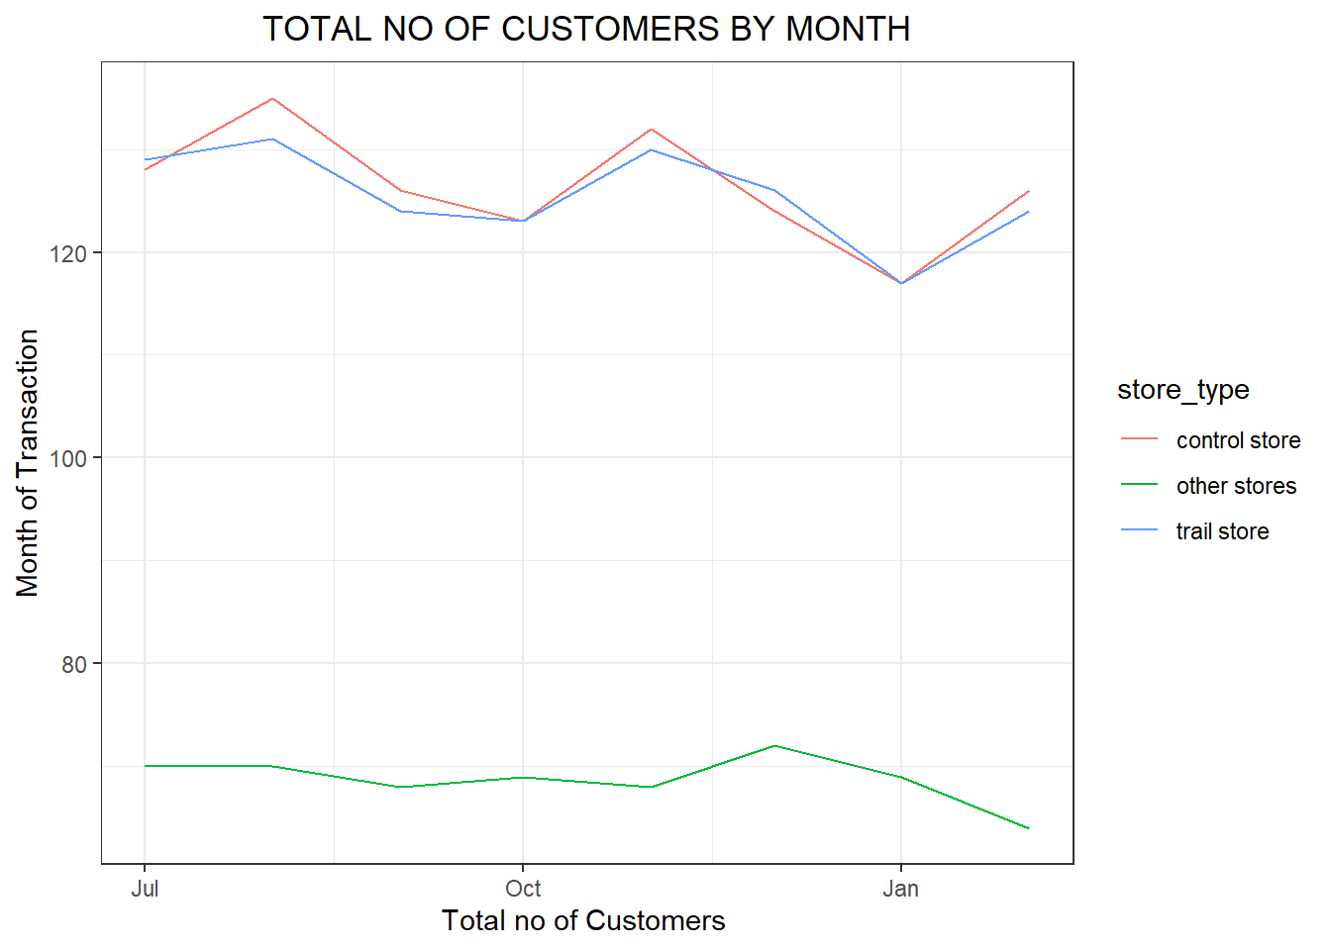
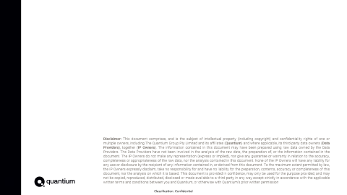
Explanation of the control store vs other stores
Other stores in comparison with control stores had a boost in no of sales and no of customers during the trial period
Trail store-77
Control store - 233
Trail store – 86
Control store - 155
Trail store – 88
Control store - 237

Slide 10
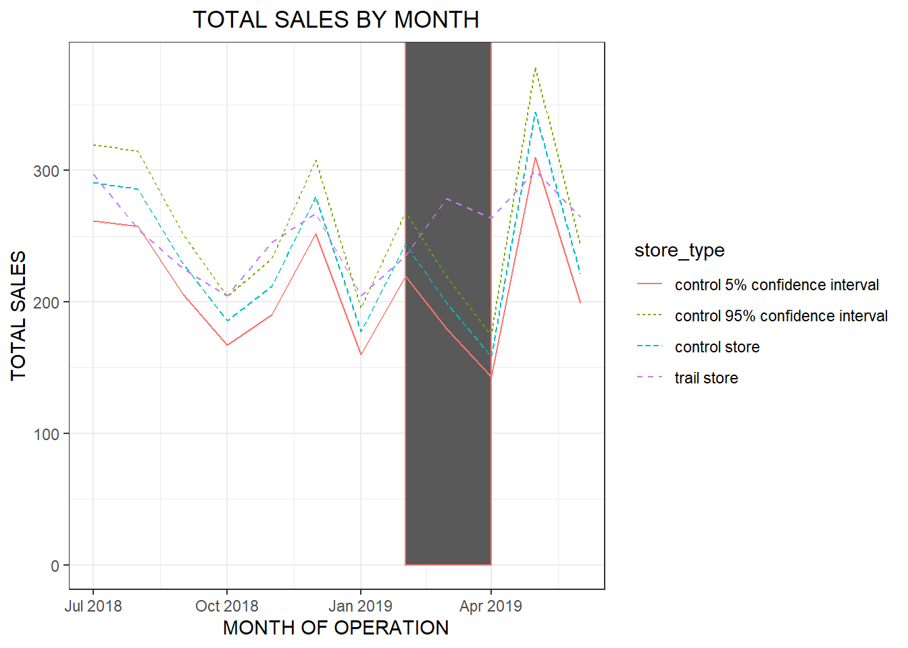
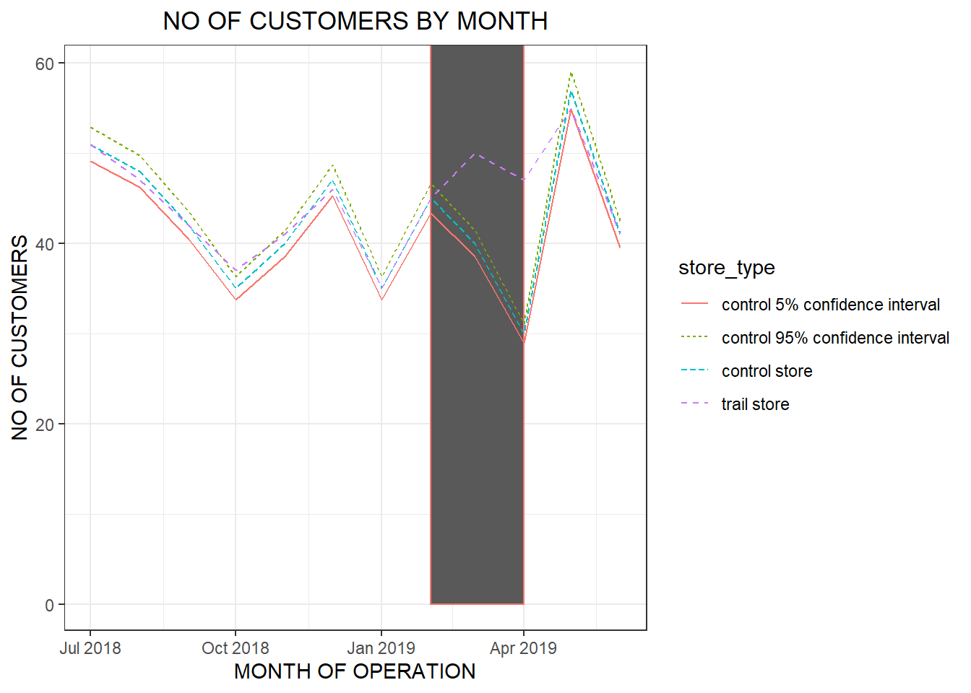
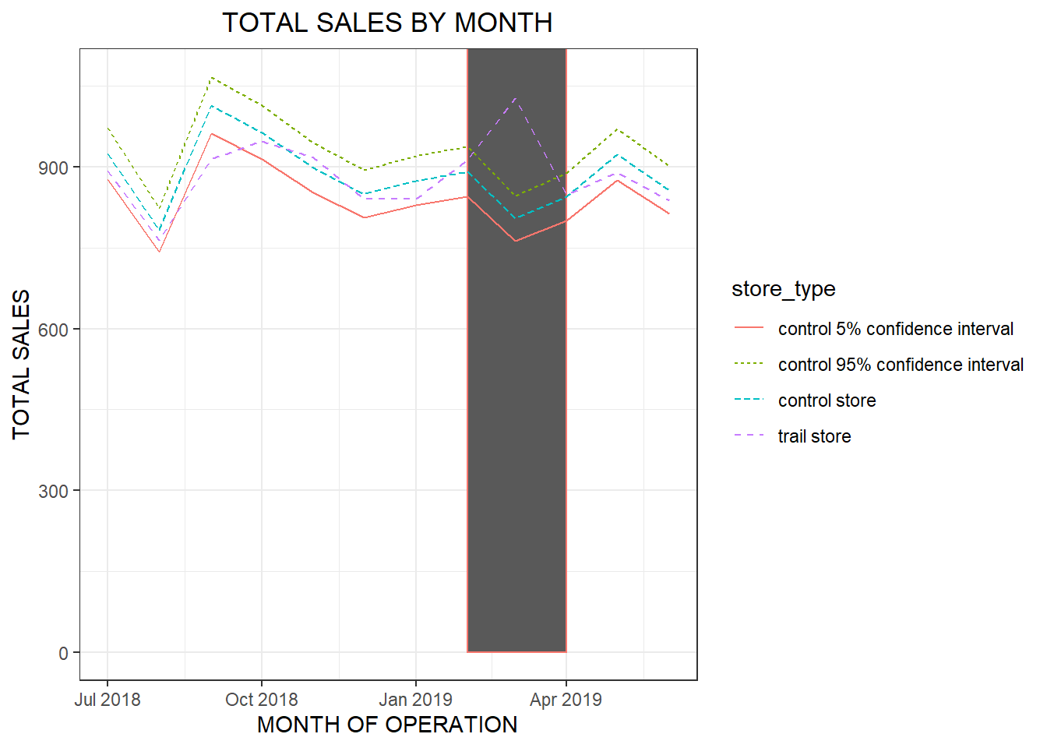
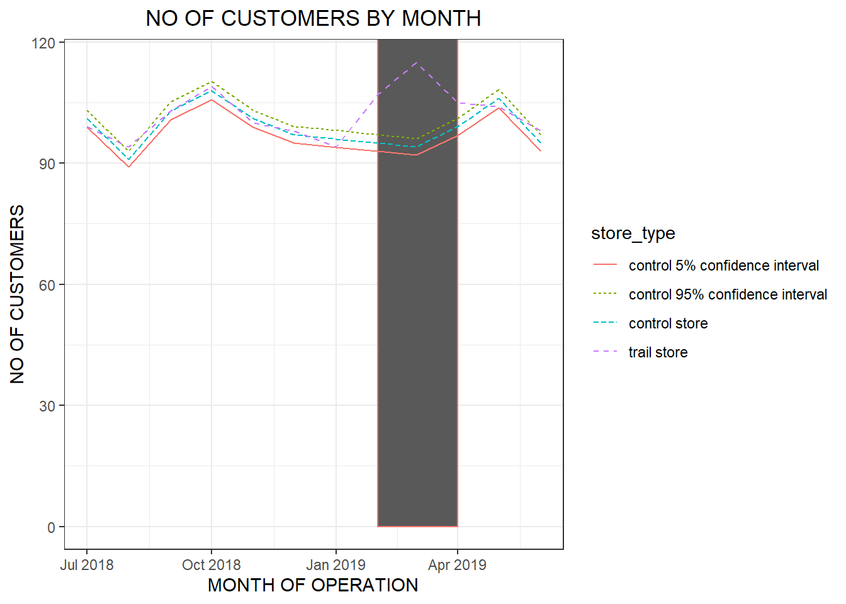
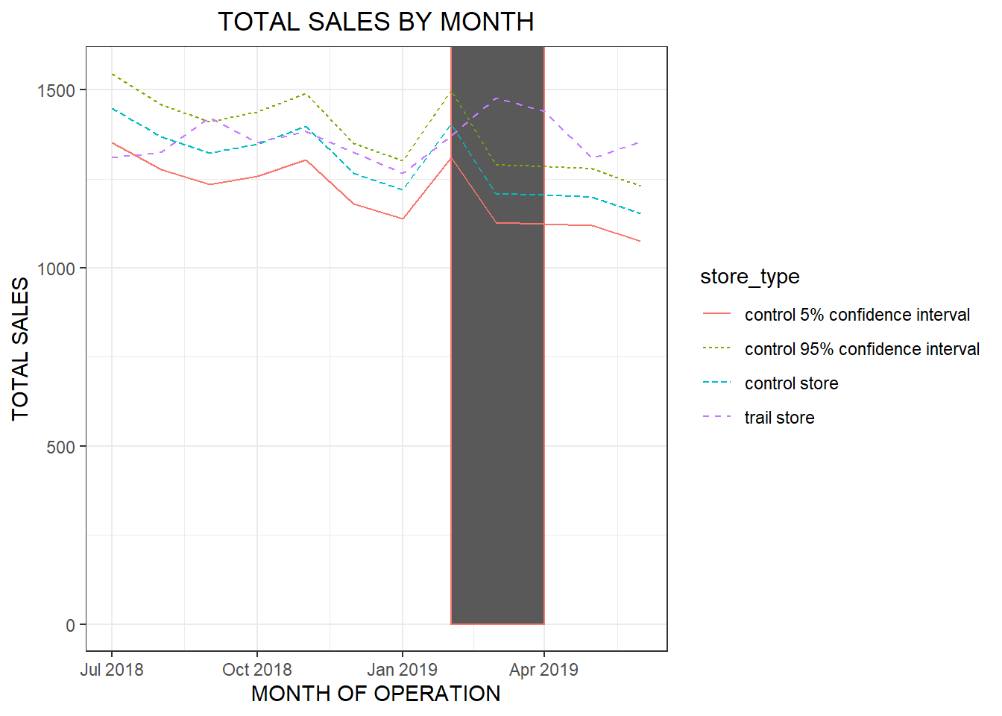
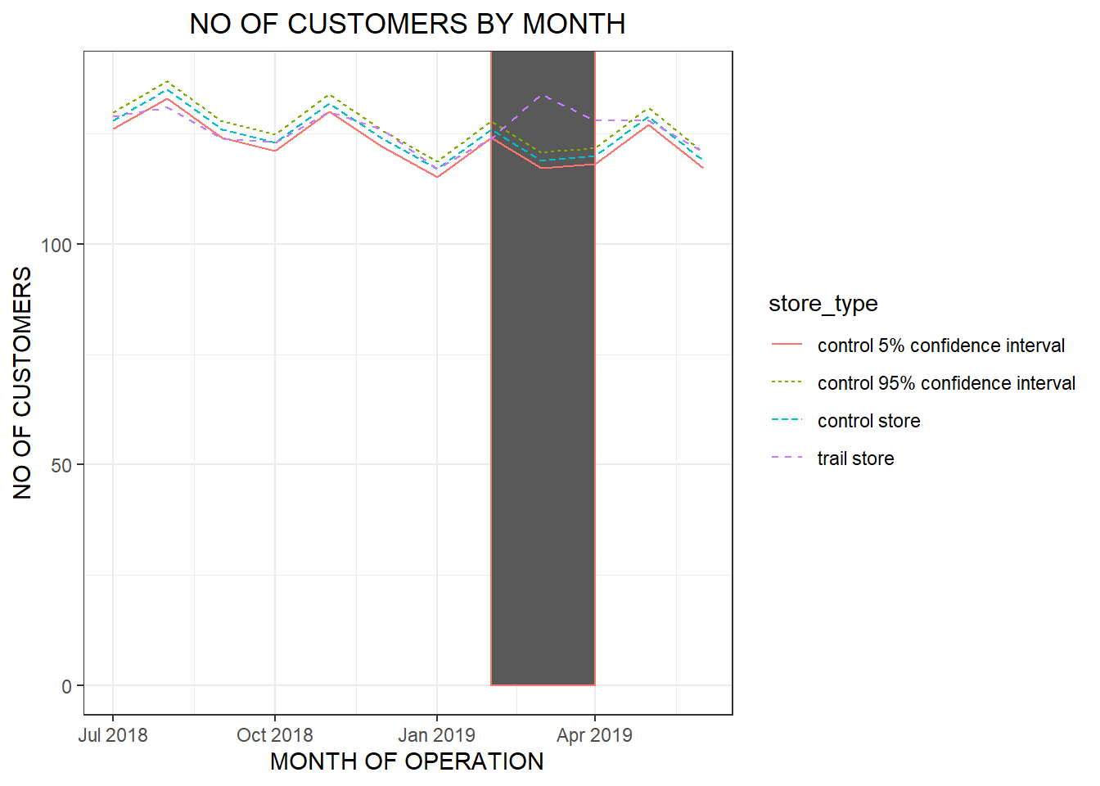
The performance of trail store had a significant increase during the trail period i.e from the month of February- April. Both the Sales and the no of Customers had increased significantly.
Trail store-77
Control store - 233
Trail store-86
Control store - 155
Trail store-88
Control store - 237

